Slide 1
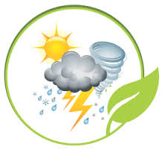
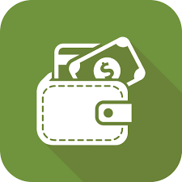
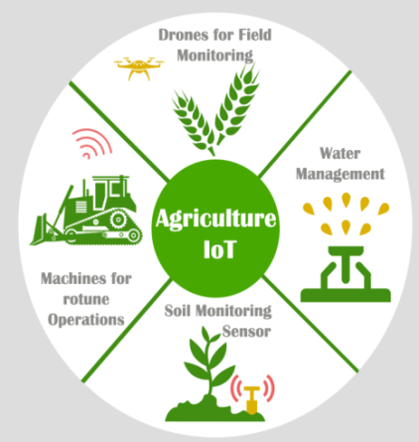


BLOCKCHAIN CROP INSURANCE ECOSYSTEM
Claims System
Weather station database e.g.: ears.nl
Claims data capture rules
Claims validation rules
Claims Valuation rules
Claims billing and settlement rules
Claims payout through Farmers Wallet
CROP INSURANCE DAPP
(aka SMART CONTRACT)
Agricultural IOT devices
Policy Administration System
Billing System
GPS tracking
Notes:
the smart contracts would trigger as soon as the data about the shortage of rainfall in a particular season is uploaded onto the Blockchain. Upon triggering, the smart contracts would help customers get their claim in an entirely automated process, without the need for insurance companies to spend precious resources on the verification and processing of their claims.

